Slide 1

Remote Excavator Team
Alec Boyce
Ryan Fortier
Davis Geniza
Oscar Nunez
Zhiyu Wang

Slide 2
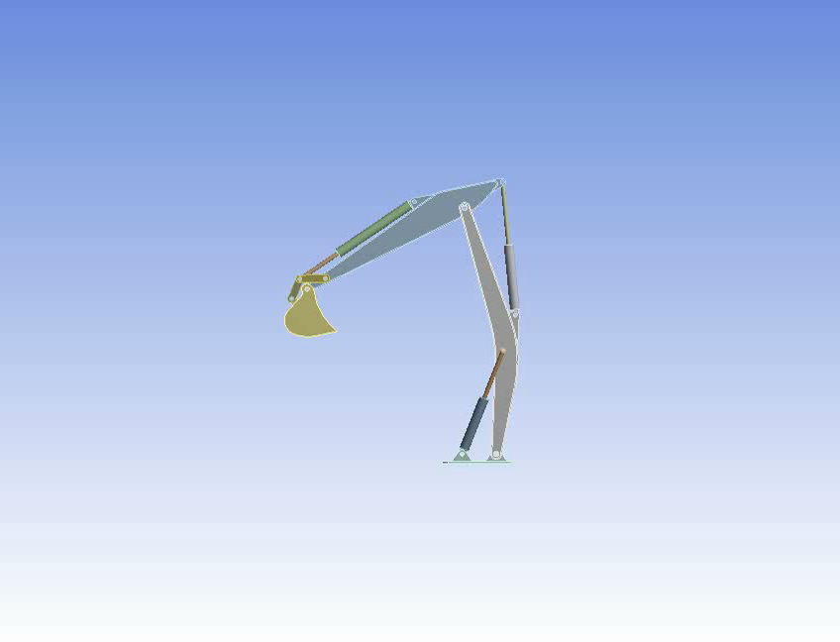
Kinematic motion & FEA
Excavator Arm-FEA
Kinematics
Range of Motion
Initial Force Calculations
Initial Stress Analysis
Future FEA & optimizations

Slide 3
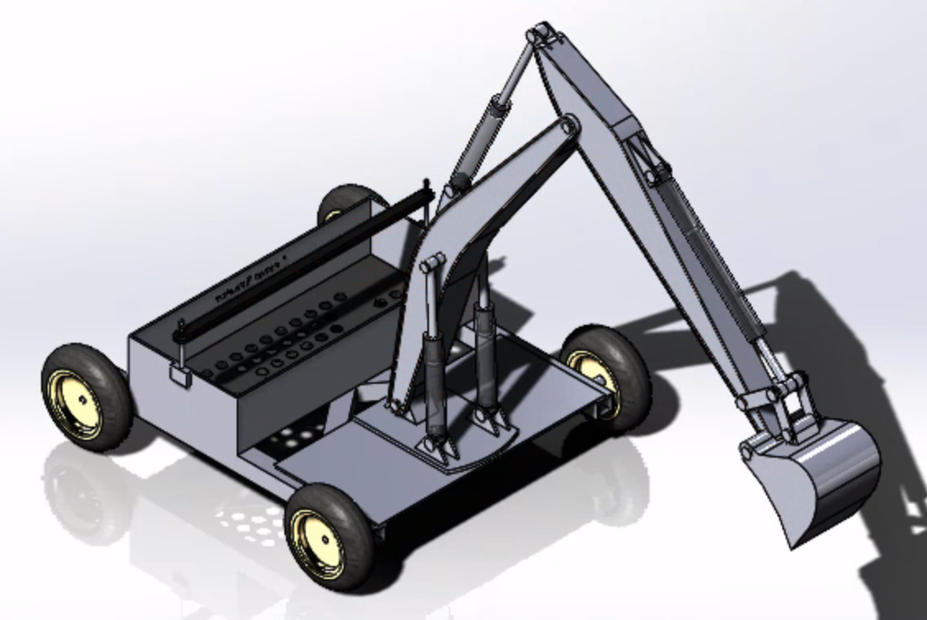
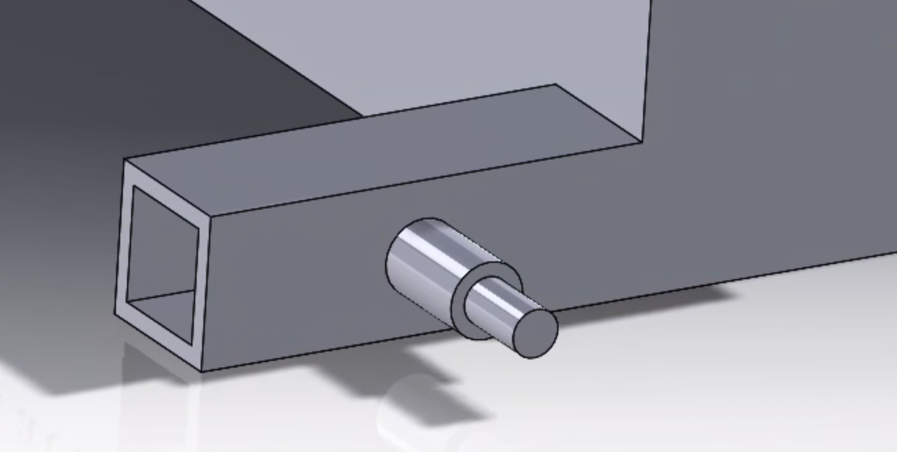

Design Description
Full assembly of design
Rubber pad under battery
Fastener
Holes for weight and cleaning
Wheels
Mounting plate
Crane style
Hydraulic
Cross Beams
Rear right side
Hollow frame
Shaft is stepped down from 1” to 5/8”
Frame extends beyond battery box

Slide 4
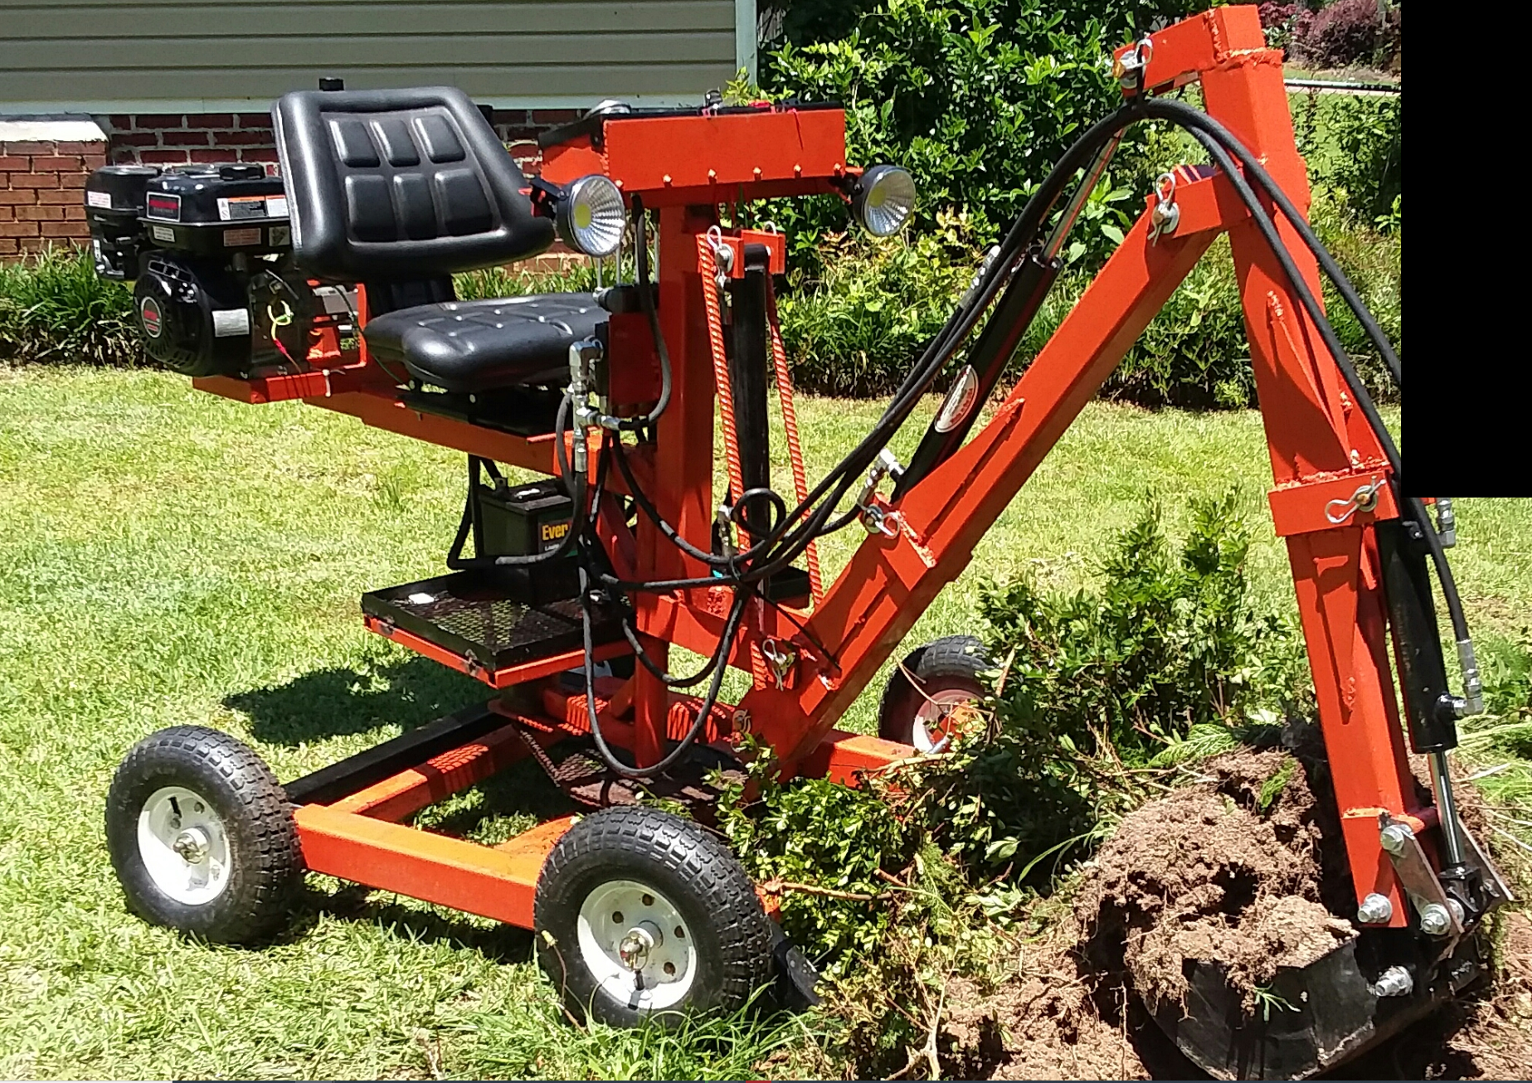
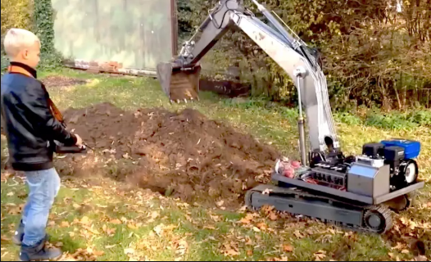
Customer/ Engineering Requirements
Electric
Portability
Remote Operated
Last an Entire Workday
Dig 1'x6" Irrigation Trench
Ground Penetrating Radar

Slide 5
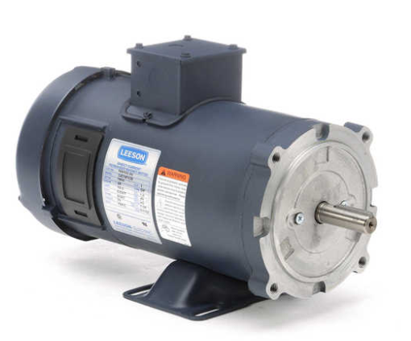
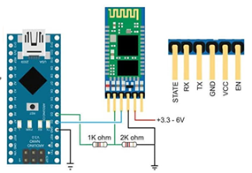
Testing Procedures
Electrical Tests – Arduino Sketch Validation, Bluetooth Module, Potentiometer, Expansion Module Shield, Motor testing
Frame Tests – FEA, Weight testing, Force tests
Power Supply – Battery-Engine testing, Charge Hold, Recharge tests, Weight
Hydraulics – Connection to Electronic Control Unit, Connection to Engine

Slide 6
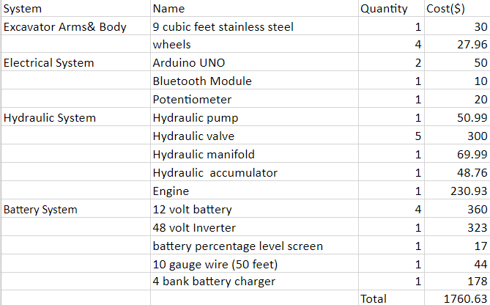
Project Plan- Zhiyu
Cost Calculate

Slide 7
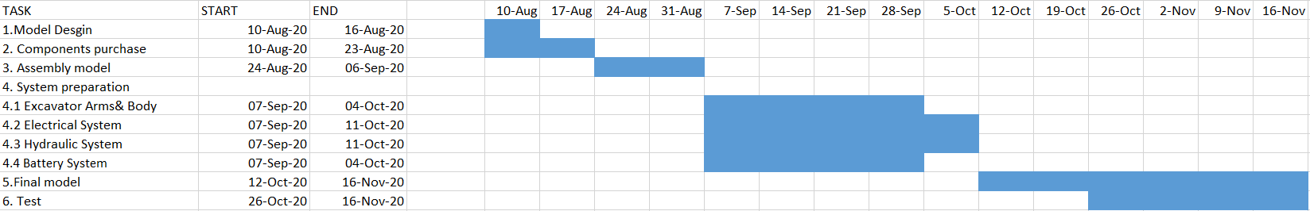
Project Plan- Zhiyu
Gantt chart for Next Semester

Slide 8
Questions?

